Slide 1
Acquired Unilateral Superior Oblique Palsy
Presenter:Dr Vaishali Prajapati
Dr. Aneri Shah
Dr. Lisa Patel
Dr. Darshavi Patel
Dr. Dhruvi Shah
GMERS medical College, sola, Ahmedabad

Slide 2
History
A 63 year old male presented with sudden onset binocular painless diplopia and hyperdeviation of left eye since 1 week, which was painless and nonprogressive.
No history of trauma, surgery, pain, redness, discharge or other systemic complains.
Patient complained of binocular diplopia which was for both near and far distance and was more appreciated by patient when he looked downwards which caused great problems with reading, eating and going downstairs. It was greatest in right gaze and inferior field of view, in dextrodepression
Pt was a known case of hypertensive on irregular medication, whose blood pressure on examination was 190/100 mm of Hg.

Slide 3
General examination was normal except high blood pressure
Ophthalmic Examination
Best corrected visual acquity (BCVA) was 6/9 in right eye and 6/6 in left eye for snellen’s chart and N6 snellen’s for near in both eyes.
Patient had a compensatory head posture with the chin lifted, face turned towards the right side, and a head tilt to right. Extra ocular movements were full and free in both the eyes with inferior oblique over action in left eye.
On Hirschberg corneal reflex test(HBCRT): left eye hypertropia with 10* exotropia
Cover test after covering right eye, left eye was 10 degrees exotropia, which after covering left eye right eye was in 45 degrees exotropia.
Alternate cover test: secondary deviation was more than primary deviation indicating it as a paralytic etiology
Park-Bielschowski's three step test suggested a left superior oblique (SO) palsy .

Slide 4
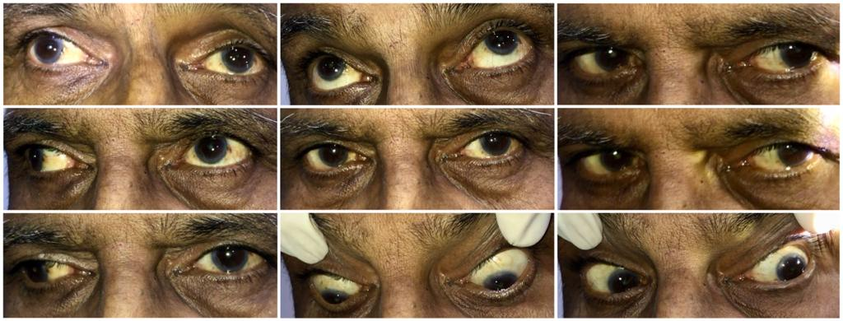
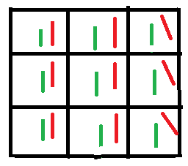
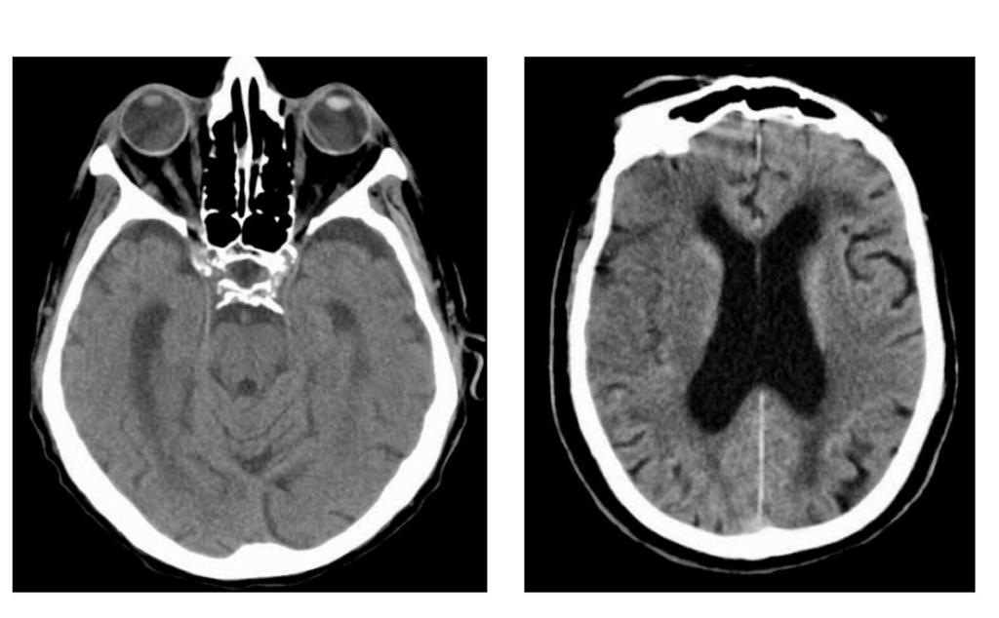
Clinical Photograph of 9 cardinal gazes at presentation
Diplopia Charting S/o left Superior Oblique & Medial Rectus Under action
CT scan S/o Periventricular changes and cerebral cortical atrophy
Anterior segment : Normal in both eyes
Pupillary reaction: Normal in both eyes.
Ocular movement: Normal except Left eye mild adduction & intortion affected.
Fundus examination: Normal in both eyes.

Slide 5
Diagnosis : left eye superior oblique & medial rectus palsy due to microvascular changes of uncontrolled hypertension
Treatment :
Strict control of hypertension
Occlusion while climbing, road crossing
Supplements: Multi-vitamins
Temporary plastic prisms fitted to the patient’s glasses if patient wants
We only had 2 months of follow-up, in case it does not improve by 6 months surgery is required.
Surgical options are inferior oblique myectomy or superior oblique tuck

Slide 6
DISCUSSION:
Etiology: Most commonly superior rectus palsies are congenital.
Congenital (40%)
Trauma (34%)
Idiopathic
Cavernous sinus and superior orbital fissure syndrome
Pseudo paralysis
Vascular and neurogenic (3-5%): Aneurysm, ocular myasthenia gravis, diabetic neuropaty, herpes zoster, Hypertension, High cholesterol, Smoking
Four golden rules
Vertical strabismus is caused by superior oblique palsy until proven otherwise
Superior oblique palsy is congenital until proven otherwise
Superior oblique palsy is traumatic if not congenital
If not congenital or traumatic-neurologic consultation

Slide 7
Management
Non-surgical :Occlusion while climbing or crossing road
In adults for small squints or temporary measure for large squint: temporary plastic prisms fitted to patient’s glasses.
surgery- inferior oblique myectomy or superior oblique tuck
Indications for surgery:
- When acquired and not corrected after 6 months
- Complains of diplopia or tilting of image
- Functionally significant hypertropia
- Anomalous head posture
- When prisms cannot compensate or eliminate vertical diplopia

Slide 8
References
Sargent J. C. Nuclear and infranuclear ocular motility disorders. In: Miller N. R., Newman N. J., editors. Walsh and Hoyt’s Clinical neuroophthalmology. Maryland, Md, USA: Lippincott Williams and Wilkins; 2005. pp. 969–1040.
Newman N. J. Third, fourth and sixth-nerve lesions and the cavernous sinus. In: Albert D. M., Jackobiec F. A., editors. Principles and Practice of Ophthalmology. Vol. 3. Pennsylvania, Pa, USA: WB Saunders; 2008. pp. 4071–4100.
Helveston E. M., Mora J. S., Lipsky S. N. Surgical treatment of superior oblique palsy. Transactions of the American Ophthalmological Society. 1996;94:315–328.
John D.F. Superior Oblique Palsy. In: American Academy Of ophthalmology; Oct 27,2015
Agarwal I, Naik M, Sethi H. Idiopathic Isolated Acquired Steroid Dependent SO Palsy: A Rare Case Report. Case Reports in Ophthalmological Medicine. 2019 ;2019:4812380. DOI: 10.1155/2019/4812380
von Noorden GK, Murray E, Wong SY. Superior Oblique Paralysis: A Review of 270 Cases. Arch Ophthalmol. 1986;104(12):1771–1776. doi:10.1001/archopht.1986.01050240045037
Thank you

